Slide 1
RBFN (RADIAL BASIS FUNCTION NETWORK)

Slide 2
Two types of FFNN
FF NN trained with BP ( FFBPNN)
consist of neurons organized into one input layer and one output layer and several hidden layers of neurons
Statistical neural Networks (SNN)
based on statistical methods and probability theory. Two of the most important types of SNNs are:
Radial basis Function neural networks(RBFNs)
Probabilistic Neural networks(PNNs)

Slide 3
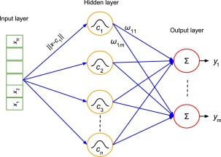
RBFN (RADIAL BASIS FUNCTION NETWORK)
RBFN is a three-layer feed-forward network with single hidden layer

Slide 4
RBFN is a popular alternative to Multilayer Perceptron (MLP) with diverse applications.
It has a simpler structure and a much faster training process
RBF neural network most commonly uses Gaussian function as transfer/activation function.

Slide 5
Each RBF neuron computes a measure of the similarity between the input and its prototype vector (taken from the training set).
Input vectors which are more similar to the prototype return a result closer to 1.
There are different possible choices of similarity functions, but
the most popular is based on the Gaussian function (Normal distribution fn).

Slide 6
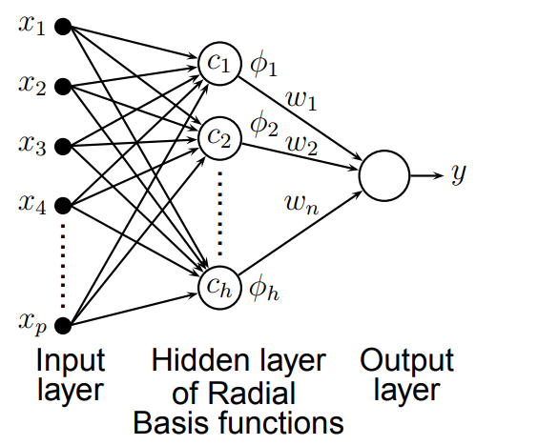

Slide 7
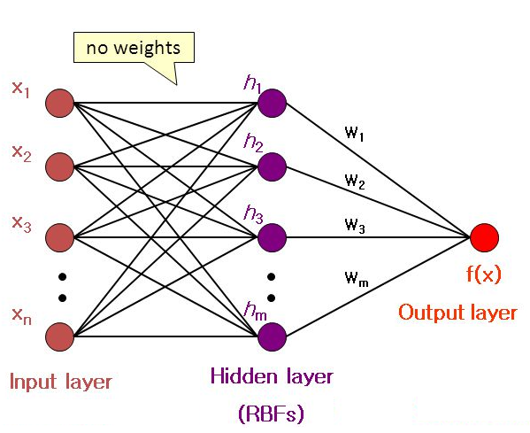
Architecture of RBFNN- Three layers
The input layer is simply a fan-out layer and does no processing.
Hidden layer performs nonlinear transformation
Output layer is linear activation for function approximation & sigmoid activation for classification.

Slide 8
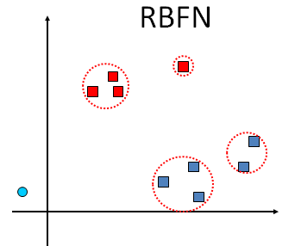
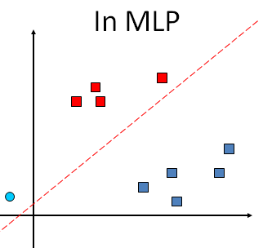
RBF NN uses Gaussian functions to construct local approximations to non-linear I/O mapping.
FF NN construct global approximations to non-linear I/O mapping.

Slide 9
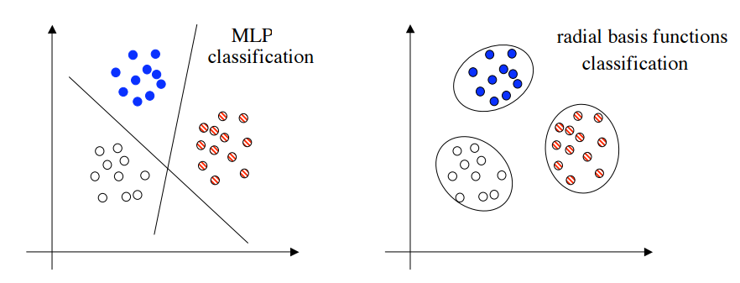

Slide 10
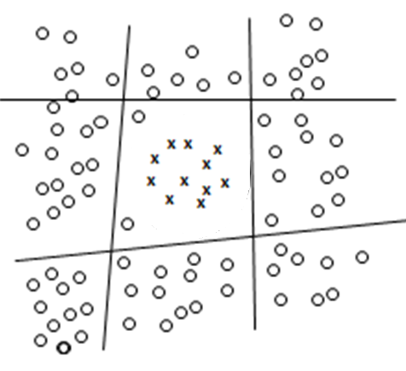
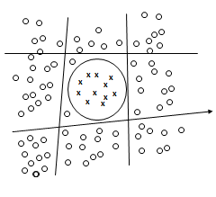
4 or 5 hidden nodes in FF network
Only 1 RBF node is required if the function can approximate the circle

Slide 11

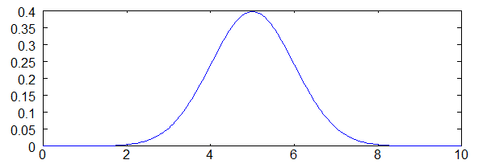
x is the input, c/µ is the mean, and σ (sigma ) is the spread/standard deviation.
This produces the familiar bell curve shown below, which is centered at the mean, c/µ
(mean is 5 and sigma is 1).

Slide 12



Controls the height of Gaussian curve
Height is maximum at x = µ = x_{m}
smaller σ means greater height

Slide 13
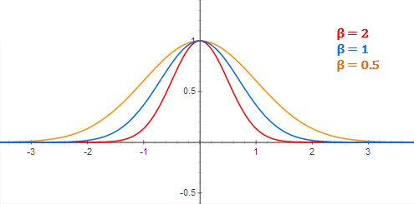
For RBFNs, instead of talking about the standard deviation (‘sigma’) directly, we use the related value ‘beta’:

Slide 14
For RBF neuron activation function, outer coefficient, term which controls the height of the Gaussian is removed. Is height of Gaussian function is redundant ?
YES, because of the weights applied from hidden to output nodes.
During training, the output nodes will learn the correct coefficient or “weight” to apply to the neuron’s response

Slide 15
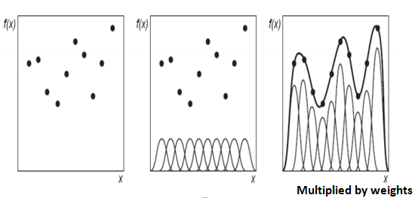
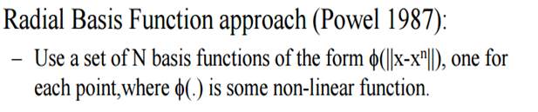

Slide 16
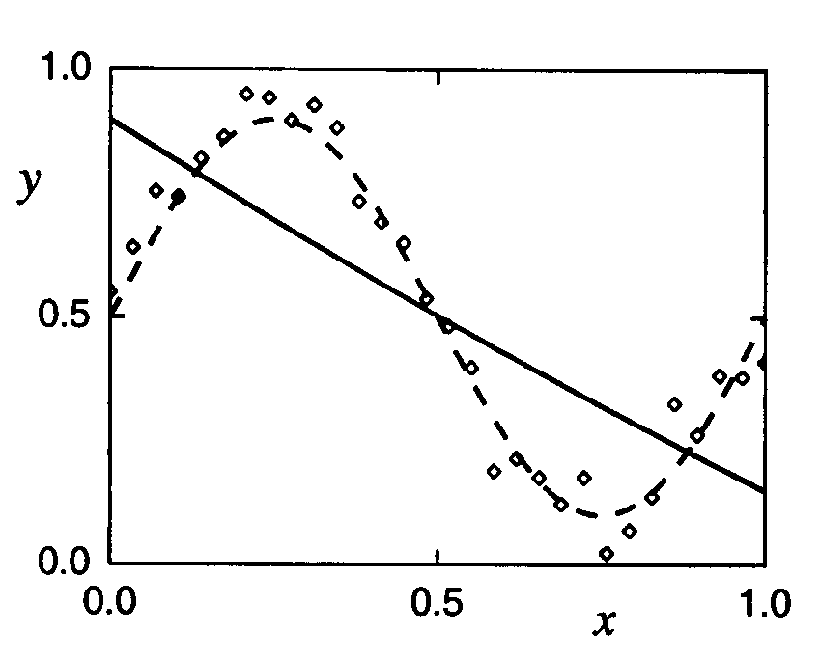
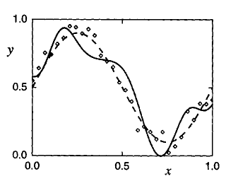
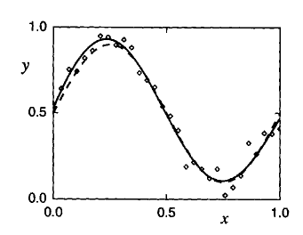
σ = 10
σ = 0.08
FUNCTION APPROXIMATION
σ = 0.4
The fraction of overlap between each hidden unit and its neighbors is decided by the width sigma such that a smooth interpolation over the input space is allowed.

Slide 17
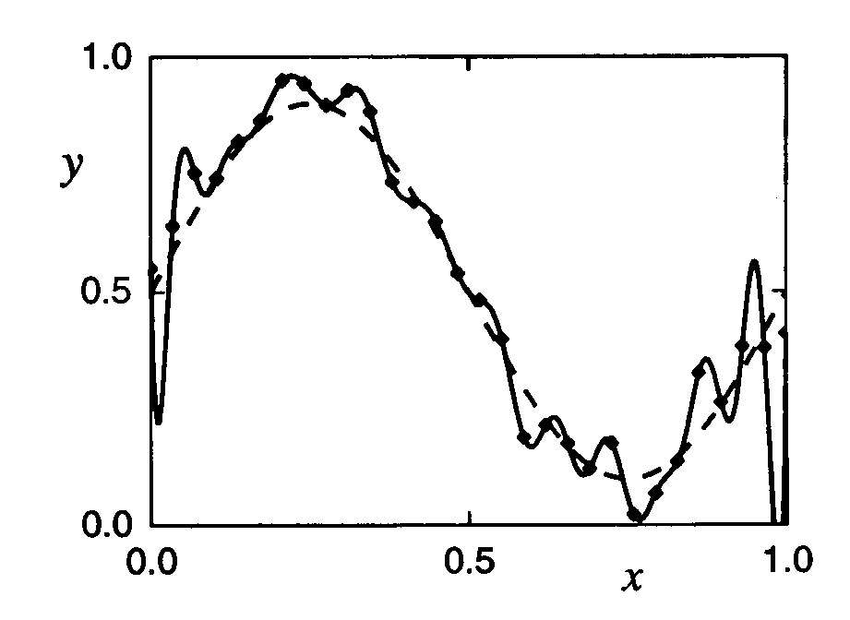
30 data points
30 basis functions
5 Basis functions
In which case number of basis functions/prototypes are less
More radial basis neurons implies more complexity, but over fitting
too few basis functions cannot fit the training data adequately due to limited flexibility-under-fitting

Slide 18
The number of basis functions controls the complexity and the generalization ability of RBF networks.
Max no. of radial basis neurons = number of input patterns
Min no. of radial basis neurons = experimentally determined
Selection of the RBF centers is most critical to RBF network implementation.
The centers can be placed
on a random subset from training examples
all of the training examples,
determined by clustering or via a learning procedure.

Slide 19
Two levels of Learning
Center and Spread of RBF neurons
2. Weights from hidden to output layer

Slide 20
RBFNN have 5 parameters for optimization:
1- The weights between the hidden layer and the output layer. 2- The activation function. 3- The center of activation functions. 4- The spread of activation functions. 5- The number of hidden neurons.

Slide 21
RBF training is usually divided into two stages.
First, the CENTERS of the hidden RBFNs layer are determined by clustering algorithms.
Optimal σ is obtained through trial and error
Second, the WEIGHTS connecting the hidden layer with the output layer are determined by
Pseudo-inverse method [ Analytical method],
Singular Value Decomposition (SVD) [ Analytical method],
Least Mean Squared(LMS) algorithms[ Supervised learning].

Slide 22
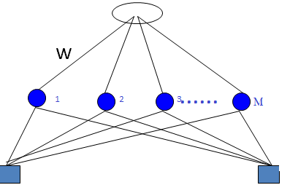
Learning Algorithm 1
Weights are computed by means of the pseudo-inverse method.
i^{th} pattern (x_{i} ), target output (d_{i} )
Dimension of x_{i} and c₁ c₂…. c_{M}
For binary dates xi is 2-D, so are centres, taken from samples
c₁,…. c_{m} are centres(mean) of Gausiaan functions at these nodes, which are
selected randomly from training data set

Slide 23
This can be re-written in matrix form for one i^{th} example
and for all the N examples/patterns (x₁, x₂, …x_{i} ,…x_{N} )

Slide 24
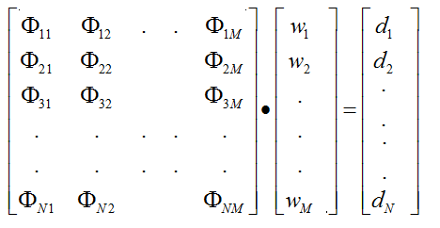
N patterns, M hidden units, expressing all input-output pairs in matrix form
In general number of hidden units is much less than number of inputs, so we do not always have a Square matrix

Slide 25
This algorithm using Pseudo inverse overcomes many issues in traditional gradient algorithms such as stopping criterion, learning rate, number of epochs and local minima.
Due to its shorter training time and generalization ability, it is suitable for real-time applications.

Slide 26
Learning Algorithm
Centers: are selected at random
centers are chosen randomly from the training set
Spreads: are chosen by normalization:
d_{max} : Maximum distance between two patterns, chosen as centers
M : Number of centers (RBF units) in hidden layer

Slide 27
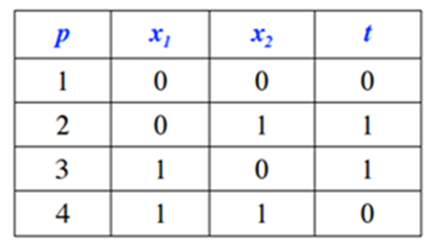
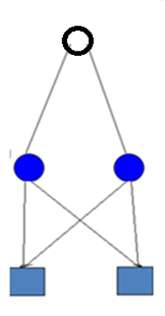

Solving EX-OR Problem using RBFN, Nonlinearly separable
Number of pattern=4
Draw Architecture

Slide 28
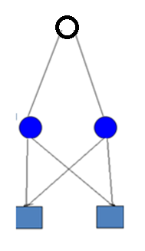
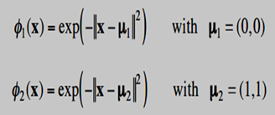
Two patterns (0,0) and (1,1)are chosen as Centres(random)
Maximum Euclidean Distance between them is
d =[ (1-0)² + (1-0)² ]^{0.5} = =(2)^{0.5}
M = 2(no. of hidden radialbasis neurons)

Slide 29

HOW MANY SUCH EXPRESSIONS WE NEED ??
TRY WRITING

Slide 31
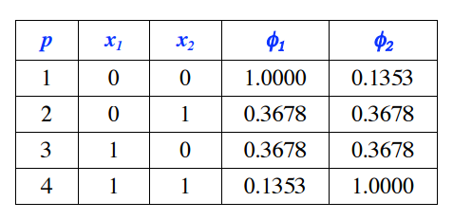
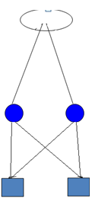
ANY OBSERVATION ???

Slide 32
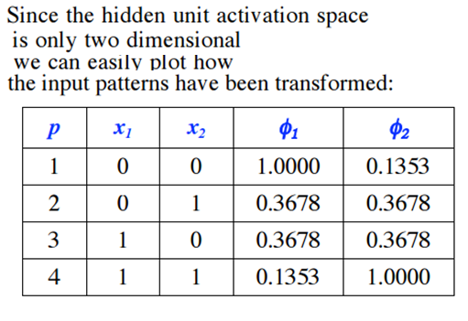

Slide 33
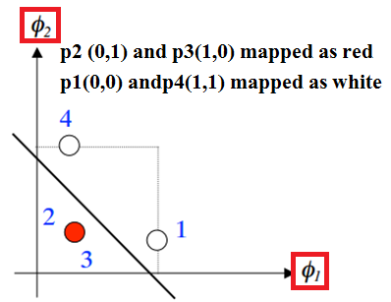

Slide 34
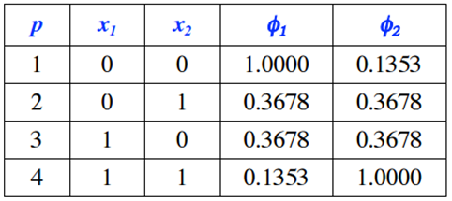
How to find unique solution ?
Three different equations so should have 3 parameters [ w₁ ,w₂ and b ] to find unique solution

Slide 35
X ₁ = pattern 1(= 0,0) X₂ = pattern 2(= 0,1)
X₃ = pattern 3(= 1,0) X₄ = pattern 4(=1,1), bias weight is negative

Slide 36
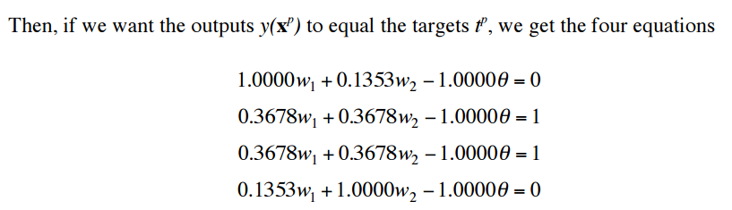
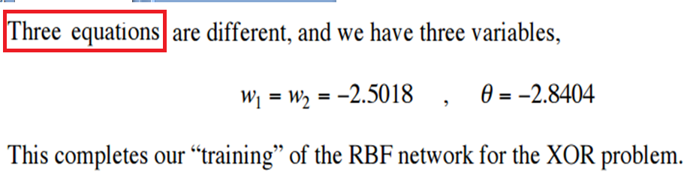

Slide 37
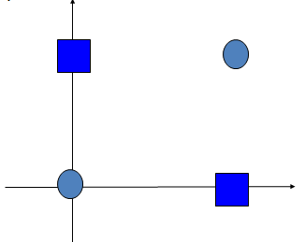
Example: XOR problem with four RBF neurons placed at position of each pattern vector
x d
(0,0) 0
(1,1) 0
(0,1) 1
(1,0) 1
w
Centers chosen as data points

Slide 38
Maximum Euclidean Distance between them is
d =[ (1-0)² + (1-0)² ]^{0.5} = =(2)^{0.5}

Slide 39
XOR problem, all four patterns are centres of RBF neurons
w

Slide 40
w

Slide 45
w

Slide 46
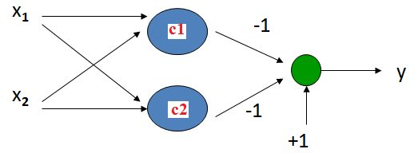
RBF NN for the XOR problem as classification problem with weights and bias found by BPA
VERIFY

Slide 49
The function newrb in Matlab iteratively creates a radial basis network one neuron at a time.
Neurons are added to the network until the sum-squared error falls beneath an error goal or a maximum number of neurons has been reached.
The call for this function is
net = newrb(P,T,GOAL,SPREAD)
The function newrb takes matrices of input and target vectors P and T, and parameters GOAL and SPREAD,
and returns the desired network.

Slide 50

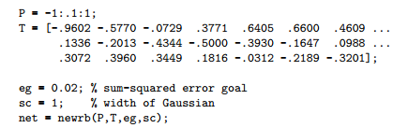
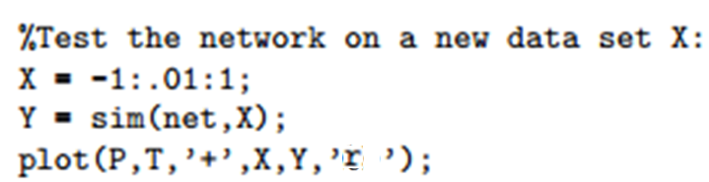

Slide 51
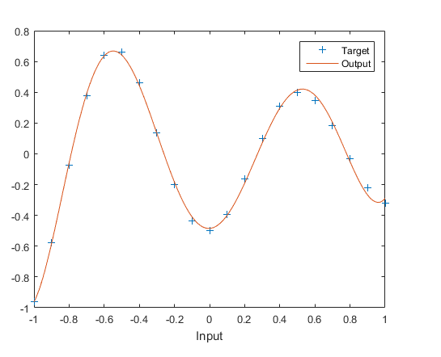
Output smooth because drawn at intervals of 0.01

Slide 52
This function newrbe creates as many radbas neurons as there are input vectors(patterns) in P.
net = newrbe(P,T,SPREAD)
The function newrbe takes matrices of input vectors P and target vectors T, and a spread constant SPREAD for the radial basis layer, and returns a network with weights and biases such that the outputs are exactly T when the inputs are P.

Slide 53
CONCLUSIONS :
Radial basis function networks (RBFNs) have increasingly attracted interest for engineering applications due to their advantages over traditional multilayer perceptrons, namely
faster convergence,
smaller extrapolation errors,

Slide 54
END

